Slide 1
View Techniques
Pipes
Asynchronous data
Forms
Custom pipes
Demo app: AngularDev/Demos/04-ViewTechniques/DemoApp
To install: npm install
To run: ng serve

Slide 2
Section 1: Pipes
Overview
Simple pipes
Simple pipes example
Additional pipes
Additional pipes examples

Slide 3
Overview
Pipes can format output in an HTML template
Examples of some simple built-in pipes in Angular:
There are 13 built-in pipes in the Angular library
Each pipe is implemented as a class
For details, see https://angular.io/api/common#pipes
{{ expression | pipeName : param1 : param2 : ... paramN }}
{{ myfullname | uppercase }}
{{ mysalary | currency }}
{{ coffeetime | date : 'hh:mm:ss a' }}
3

Slide 4
Simple Pipes
Pipe name | Pipe class | Description
lowercase | LowerCasePipe | Transforms text to lower-case
uppercase | UpperCasePipe | Transforms text to upper-case
titlecase | TitleCasePipe | Transforms text to title-case
json | JsonPipe | Converts a JavaScript object into a JSON string
number | DecimalPipe | Formats number as text
percent | PercentPipe | Formats number as a percentage
currency | CurrencyPipe | Formats number as a currency
date | DatePipe | Formats a date as a string
keyvalue | KeyValuePipe | Transforms an object or a map into an array of key-value pairs
4

Slide 5
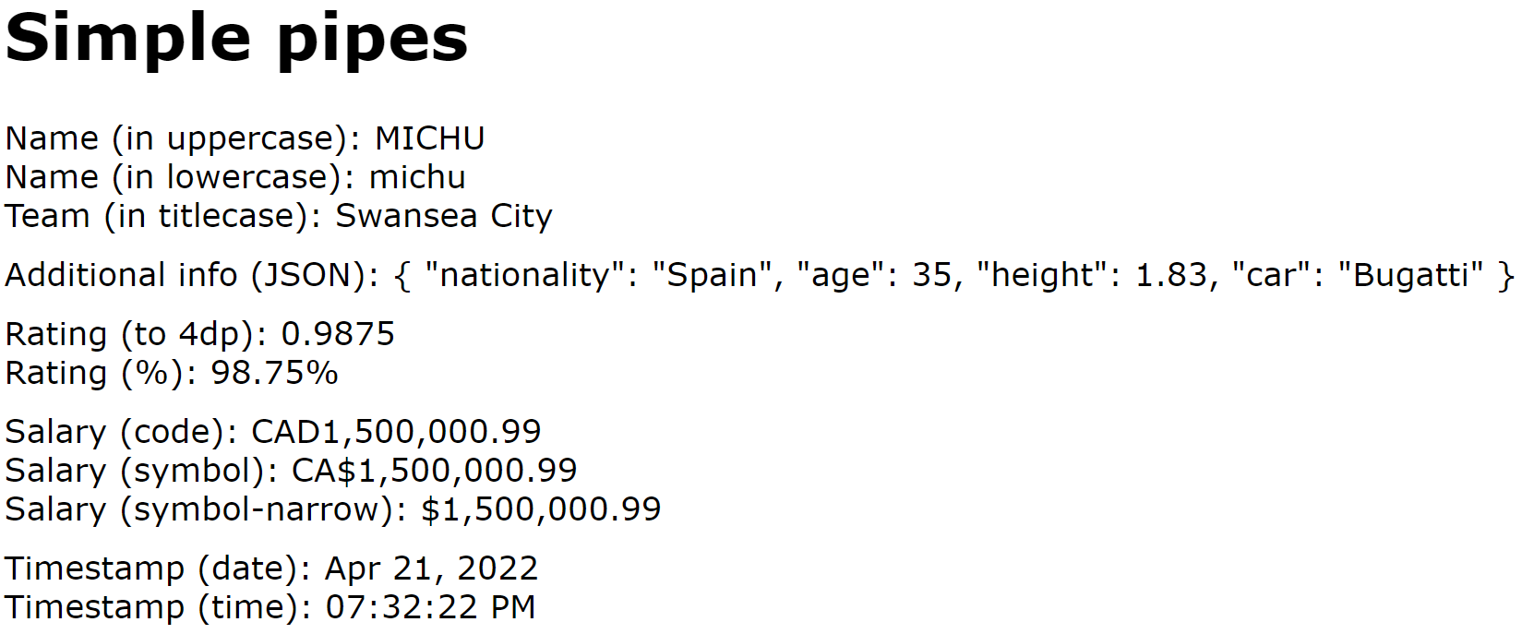
Simple Pipes Example
Let's see an example of simple pipes
In the demo app, click the Simple pipes link
See simple-pipes.component.html
5

Slide 6
Additional Pipes
Pipe name | Pipe class | Description
slice | SlicePipe | Creates a new List or String containing a subset (slice) of the elements
i18nPlural | I18nPluralPipe | Maps a numeric value into suitable plural string, e.g. 'mouse' or 'mice', 'child' or 'children', etc.
i18nSelect | I18nSelectPipe | Formats a string value into a suitably selected string, e.g. 'Dear Sir', 'Dear Madam', etc.
async | AsyncPipe | Accepts a Promise or Observable as input, and updates the view with the appropriate value(s) when the promise is resolved or the observable emits a new value.
6

Slide 7
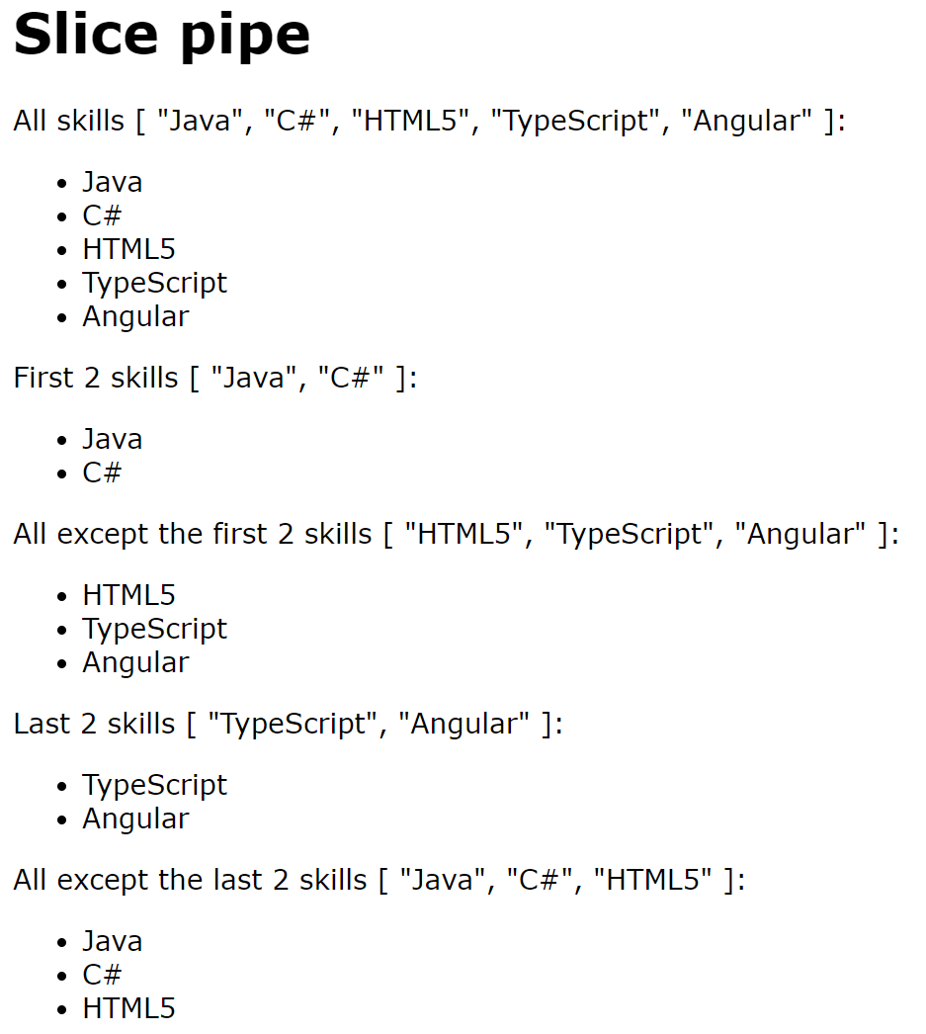
Additional Pipes Examples (1 of 3)
Let's first see an example of the slice pipe
In the demo, click Slice pipe
See slice-pipe.component.html
7

Slide 8
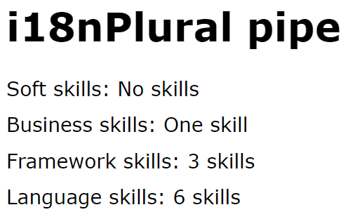
Additional Pipes Examples (2 of 3)
Now let's see an example of the i18nPlural pipe
In the demo, click i18nPlural pipe
See i18n-plural-pipe.component.html
8

Slide 9
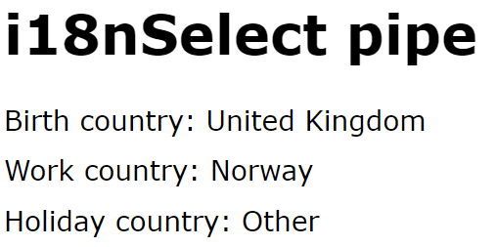
Additional Pipes Examples (3 of 3)
Now let's see an example of the i18nSelect pipe
In the demo, click i18nSelect pipe
See i18n-select-pipe.component.html
9

Slide 10
Section 2: Asynchronous Data
Overview
Using Observable in an Angular app
How to display asynchronous data
Asynchronous data example

Slide 11
Overview
Web apps often have to deal with asynchronous data
E.g. the result of a long calculation in a Web Worker
E.g. the result of a REST service
E.g. incoming data messages from a Web Socket
There are 2 ways to handle async data in a web app:
Promise - One-off asynchronous result
Observable - Continuous stream of emitted values
11

Slide 12
Using Observable in an Angular App
Observable is not a standard ECMAScript class
You must add the rxjs dependency in package.json
(Note, Angular CLI adds this automatically)
"dependencies": {
"rxjs": "~7.8.0",
…
}
package.json
For details about the Observable class, see:
http://reactivex.io/rxjs/class/es6/Observable.js~Observable.html
12

Slide 13
How to Display Asynchronous Data
If a component has an asynchronous data property, you can display it via the async pipe
What does the async pipe do?
Waits for a Promise object to be resolved
Subscribes to data published by an Observable object
{{ aPromise | async }}
{{ anObservable | async }}
13

Slide 14
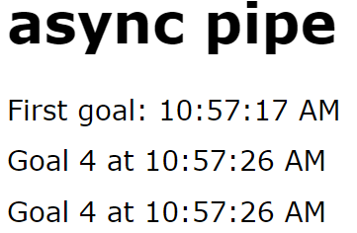
Asynchronous Data Example (1 of 3)
Let's see an example of asynchronous data
In the demo app, click the async pipe link
14

Slide 15
Asynchronous Data Example (2 of 3)
Here are the relevant bits of the TypeScript code
import {Observable, interval} from 'rxjs';
import {map} from 'rxjs/operators';
…
@Component(…)
export class AsyncPipeComponent {
firstGoal: Promise<Date>;
mostRecentGoal: Observable<Goal>;
constructor() {
this.firstGoal = new Promise((resolve, reject) => {
setTimeout(() => resolve(new Date()), 3000);
});
this.mostRecentGoal = interval(3000).
pipe(map((n: number) => new Goal(n+1, new Date())));
}
}
async-pipe.component.ts
15

Slide 16
Asynchronous Data Example (3 of 3)
Here are the relevant bits of the HTML template
<div>
First goal:
{{ firstGoal | async | date:'hh:mm:ss a' }}
</div>
<div>
Goal {{ (mostRecentGoal | async)?.goalNumber }}
at {{ (mostRecentGoal | async)?.goalTimestamp | date:'hh:mm:ss a' }}
</div>
<div *ngIf='mostRecentGoal | async as mrg'>
Goal {{ mrg.goalNumber }}
at {{ mrg.goalTimestamp | date:'hh:mm:ss a' }}
</div>
async-pipe.component.html
16

Slide 17
Section 3: Forms
Strategies for implementing forms
Adding support for forms
Examples

Slide 18
Strategies for Implementing Forms
Template-driven forms
The HTML template specifies form semantics
Reactive forms (a.k.a. model-driven forms)
The component class defines form semantics in code
18

Slide 19
Adding Support for Forms
Your app dependencies must include Angular Forms
Your component must import either FormsModule or ReactiveFormsModule
"dependencies": {
"@angular/forms": "^17.0.0",
…
}
package.json
import { FormsModule --or-- ReactiveFormsModule } from '@angular/forms';
…
@Component({
imports: [FormsModule --or-- ReactiveFormsModule, …],
…
})
export class SomeComponent {…}
some.component.ts
19

Slide 20
Examples
The demo app has examples of the forms strategies…
Click the appropriate link in the demo app:
Template-driven forms
Reactive forms
20

Slide 21
Summary
Pipes
Asynchronous data
Forms

Slide 22
Annex: Custom Pipes
Overview
Generating a custom pipe
Implementing a custom pipe
Using a custom pipe
Running the demo application

Slide 23
Overview
You can define custom pipes
Define a class and decorate with @Pipe
Implement the PipeTransform interface
import {Pipe, PipeTransform} from '@angular/core';
…
@Pipe({
name: 'someCool',
standalone: true
})
class SomeCoolPipe implements PipeTransform {
transform(value: any, ...args: any[]): string {
// Add code here, to transform the value and return the result.
…
}
}
some-cool.pipe.ts
23

Slide 24
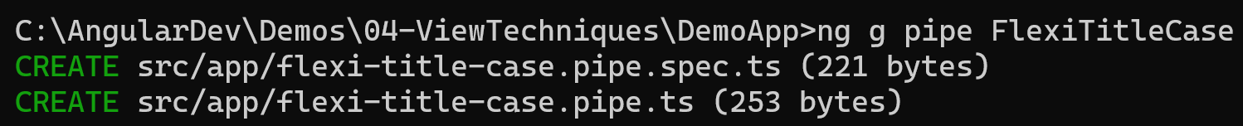
Generating a Custom Pipe
You can use Angular CLI to generate a custom pipe
For example, this is how we generated a custom pipe in the demo application:
ng g pipe FlexiTitleCase
24

Slide 25
Implementing a Custom Pipe
Here's the implementation of our custom pipe class:
@Pipe({
name: 'flexiTitleCase',
standalone: true
})
export class FlexiTitleCasePipe implements PipeTransform {
transform(value: string, upperOrLower: string): string {
if (upperOrLower !== 'upper' && upperOrLower !== 'lower')
return value;
let words:string[] = value.split(' ');
for (var i = 0; i < words.length; i++) {
if (upperOrLower === 'upper') {…}
else {…}
}
return words.join(' ');
}
}
flexi-title-case.pipe.ts
25

Slide 26
Using a Custom Pipe
You can use the custom pipe in the HTML template for a component, as follows:
<h1>Using custom pipe</h1>
<div>
Name: {{ name }}
</div>
<div>
Name (flexiTitleCase:'upper'): {{ name | flexiTitleCase:'upper' }}
</div>
<div>
Name (flexiTitleCase:'lower'): {{ name | flexiTitleCase:'lower' }}
</div>
using-custom-pipe.component.html
26

Slide 27
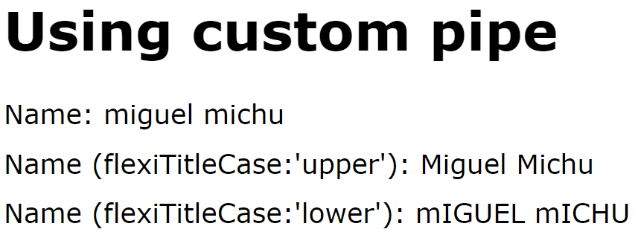
Running the Demo Application
Let's see the custom pipe in action
In the demo app, click the Custom pipes link
27

